Slide 1

Identifying Ideal Districts in Malaysia for Establishing New Gym Branches Using K-means Clustering
A PROJECT BY SOFIAH

Slide 2
Introduction

Slide 3
Malaysia has the highest rate of obesity and overweight among Asian countries.
Malaysian government promotes healthier lifestyle and living among Malaysians
Increasing awareness about fitness among the younger generation of the country.
There is an increasing demand for more gyms and fitness centers in Malaysia

Slide 4
Business problem

Slide 5
The company is looking to open their gym branches at locations which would attract a huge customer base and guarantee them a regular profit.
A hypothetical fitness-based company called “A Fitness” is interested in establishing a gym chain with branches all over the Peninsular of Malaysia

Slide 6
Problem statement

Slide 7
The goal of this project is to help the company identify the most ideal locations to open their gym centres.
The problem statement is,
“Which are the most suitable districts to open new gym centres in the Peninsular of Malaysia?

Slide 8
Data

Slide 9
The main data required for this project are as follows:
Location coordinates
Population
Age
Mean and median income
Total number of gyms currently available
Total number of shopping malls

Slide 10
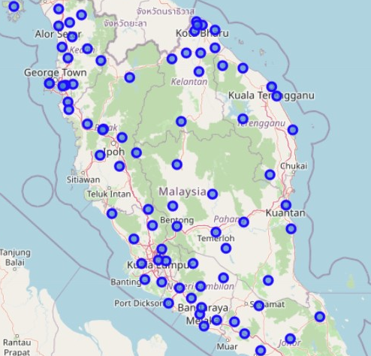
Map of Peninsular Malaysia
i) Location data
The blue points represents the 84 districts in Peninsular Malaysia

Slide 11
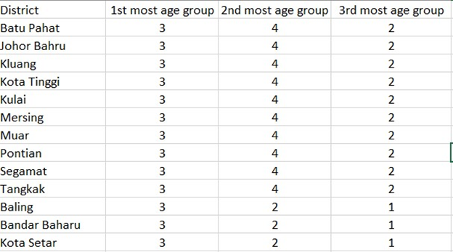
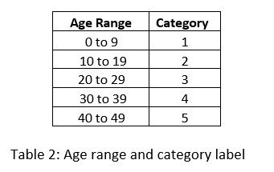
ii) Age of residents
The main age groups of residents were divided into several age range categories as shown in Table 2
Snippet of top 3 age groups of districts dataset

Slide 12
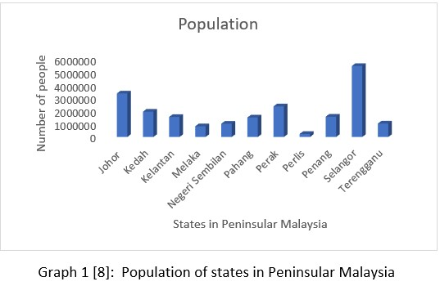
iii) Population data
Graph 1 depicts the overall population of each state in Peninsular Malaysia.
Selangor has the highest population and Perlis has the lowest population overall.

Slide 13
iv) Number of Shopping Malls & Gym
Number of Shopping Malls
The Foursquare API was used to collect information on the locations and number of shopping malls available in each district.
Number of Gyms
The Foursquare API was used to collect information on the locations and number of shopping malls available in each district.

Slide 14
v) Mean and median income
Standard gym membership fees of gyms in Klang Valley is within MYR 90 to MYR 300 per month
In 2019, the mean income in Malaysia was RM7,901 while Malaysia’s median income was RM5,873
Median monthly household disposable income was RM5,116 in 2019, and mean monthly household disposable income was RM6,764.
The target customers are people who earn MYR 4000 and above.

Slide 15
methodology

Slide 16
Exploratory Data Analysis and Inferential Statistic Testing
Collecting and Preparing Data
Clustering Using K-Means Clustering

Slide 17
Collecting and Preparing Data
i) The district names were extracted from a Wikipedia page, List Of Districts In Malaysia using the BeautifulSoup and request library. The URL of the website was parsed into the request.get() function
ii) The latitude and longitude values of each districts were obtained using the GeoPy library and Nominatim. The latitude and longitude values were obtained by looping thru the district name dataframe
iii) The age, population and income data were extracted from various websites and stored in a file together with the district’s names and latitude and longitude values
iv) The Foursquare API was used to request a search of id category “gym” within radius of 30000m. The same was repeated for id category “shopping mall”

Slide 18
Exploratory Data Analysis and Inferential Statistic Testing
The number of gyms does not depend on the population. Number of gyms is 50 or more for districts with population of 250000 or more in general
No direct relationship between median income and number of gyms
No direct relationship between mean income and number of gyms.
The number gyms increase as the number of shopping mall increases

Slide 19
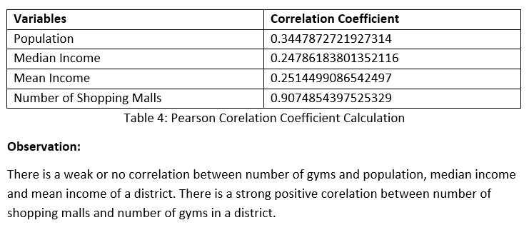
Pearson Correlation Coefficient Calculation was also calculated to determine the correlation between the number of gyms and the other variables. Results are tabulated in the Table 4 below:

Slide 20
Clustering Using K-Means Clustering
The machine learning method K-Means Clustering were used to cluster the 84 districts in to 7 different cluster group. Each cluster was labelled.
The most suitable districts to open new gym branches based on the criteria discussed in the Discussion of background section could be determined based on the characteristics of the districts in the clusters.
The clusters are mapped using Folium to visualize the clusters

Slide 21
results

Slide 22
The districts in Cluster 0 generally have low population with close to 100000 residents per district, low median and mean income per month, low total number of shopping malls, low total number of existing gyms, the majority of residents are within the age group of 0 to 29 years old.
The districts in Cluster 1 generally have medium level population with more than 100000 residents per district, low median and mean income per month, high total number of shopping malls, high total number of existing gyms, the majority of residents are within the age group of 0 to 29 years old.
The districts in Cluster 2 generally have high population with more than 100000 residents per district, high median and mean income per month, high total number of shopping malls, high total number of existing gyms, the majority of residents are within the age group of 20 to 39 years old

Slide 23
4. The districts in Cluster 3 generally have low population with close to 100000 residents per district, medium level median and mean income per month, medium level total number of shopping malls, medium level total number of existing gyms, the majority of residents are within the age group of 0 to 29 years old.
5. The districts in Cluster 4 generally have medium level population with more than 100000 residents per district, medium level median and mean income per month, high total number of shopping malls, medium level total number of existing gyms, the majority of residents are within the age group of 10 to 39 years old.
6. The districts in Cluster 5 generally have high level population with more than 100000 residents per district, medium level median and mean income per month, high total number of shopping malls, high total number of existing gyms, the majority of residents are within the age group of 20 to 49 years old

Slide 24
7. The districts in Cluster 6 generally have high level population with more than 100000 residents per district, medium level median and mean income per month, high total number of shopping malls, high total number of existing gyms, the majority of residents are within the age group of 0 to 29 years old.

Slide 25
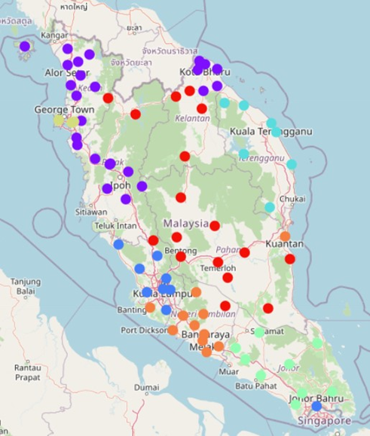
Map of Clusters

Slide 26
Conclusion

Slide 27
The districts in Cluster 3 and Cluster 4 are more suitable and ideal for the company to open new gym branches in when compared to the other clusters.
These districts matched the criteria set by A Fitness better then the districts in the other clusters.
Overall districts in Cluster 3 and Cluster 4 have about medium level population with more than 100000 residents per district, medium level median and mean income per month, medium level total number of shopping malls, medium level total number of existing gyms, the majority of residents are within the age group of 10 to 39 years old

Slide 28
The most ideal districts for the company A Fitness to open gym branches are Besut, Dungun, Hulu Terengganu, Kemaman, Kuala Terengganu, Marang, Setiu, Batu Pahat, Kluang, Kota Tinggi, Kulai, Mersing, Muar, Pontian, Segamat dan Tangkak

